Slide 1
Data Platform, Data Store, Data Security

Slide 2
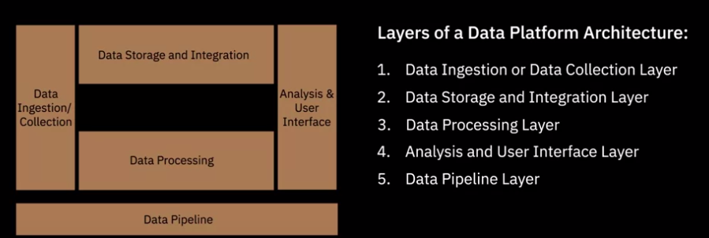
1. Architecting the Data Platform
we will learn about the layers of a data platform architecture. A layer represents functional components that perform a specific set of tasks in the data platform

Slide 3
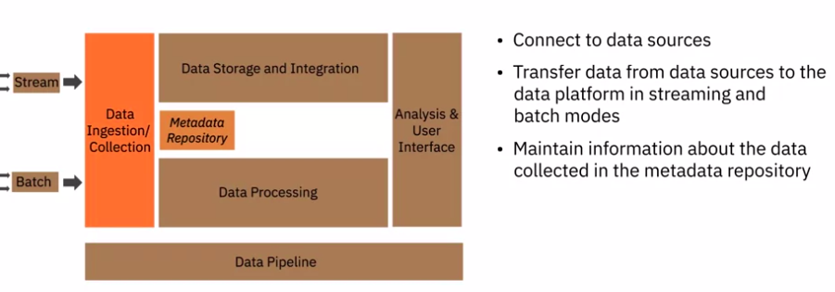
1. Data Ingestion or Collection Layer
Data Collection Layer is responsible for connecting to the source systems and bringing the data from these systems into the data platform.
For example, how much data was ingested in a batch, data source, and other descriptive information

Slide 4
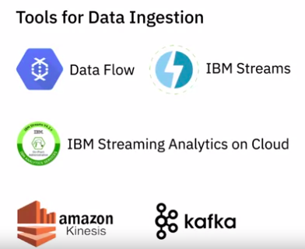
1. Data Ingestion or Collection Layer

Slide 5
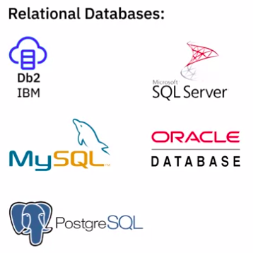
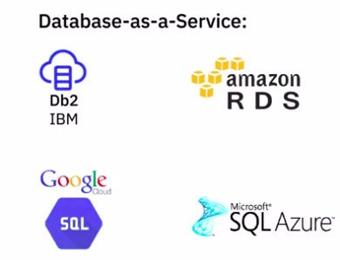
1. Data Ingestion or Collection Layer - SQL Databases

Slide 6
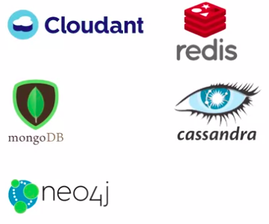
1. Data Ingestion or Collection Layer - non-SQL Databases

Slide 7
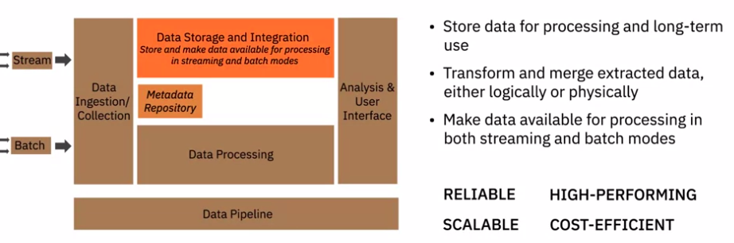
1. Data Storage and Integration
Typical use case scenario : Master Data Management

Slide 8
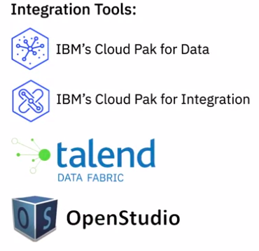
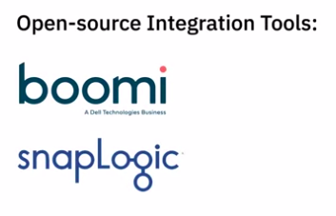
1. Data Ingestion or Collection Layer - Integration tools

Slide 9
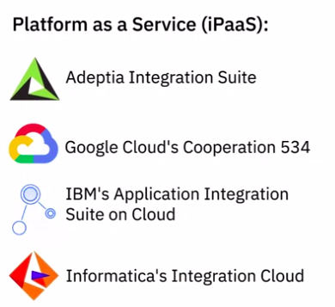
1. Data Ingestion or Collection Layer - Platform as a Service
AWS Glue

Slide 10
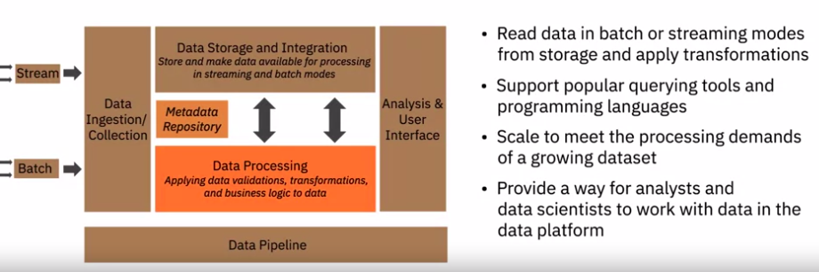
1. Data Processing

Slide 11
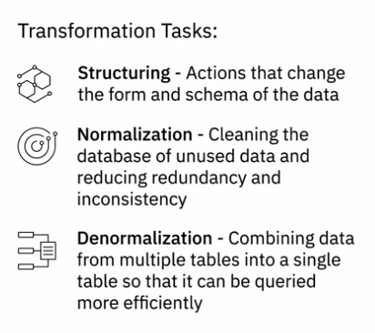
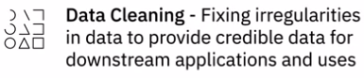
1. Data Processing - Transformation Tasks
Structuring, essentially, actions that change the form and schema of the data. This change may be as simple as changing the order of fields within a record or dataset or as complex as combining fields into complex structures using joins and unions.

Slide 12
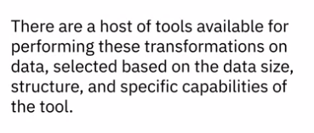
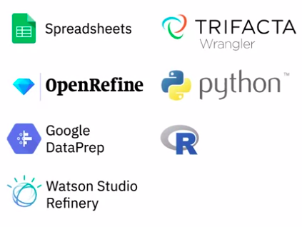
1. Data Processing - Tools
Python/R- With Libraries & packages

Slide 13
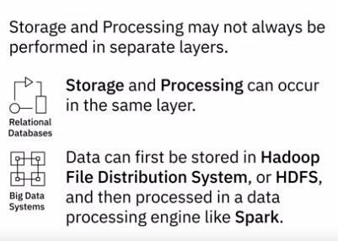
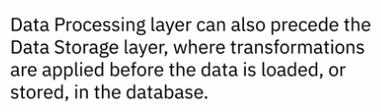
1. Data Processing - Relationship with Storage Layer

Slide 14
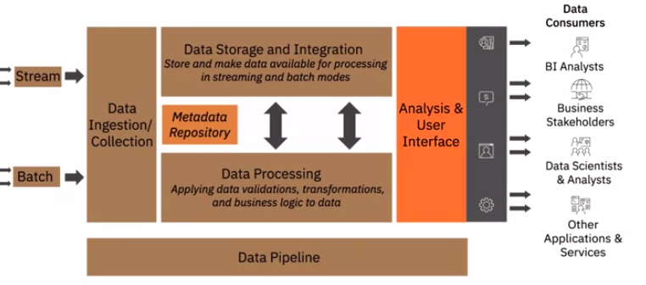
1. Analysis & User Interface
The Analysis and User Interface Layer delivers processed data to data consumers

Slide 15
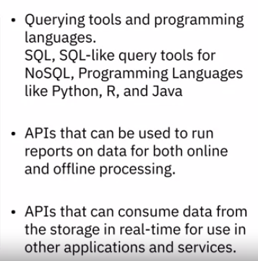
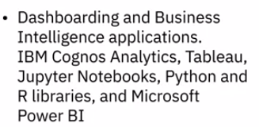
1. Analysis & User Interface

Slide 16
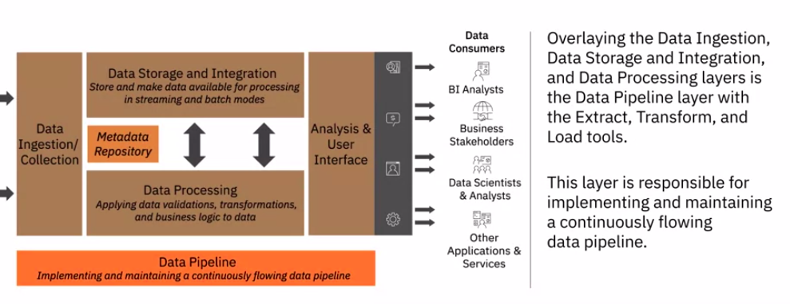
1. Data Pipeline

Slide 17
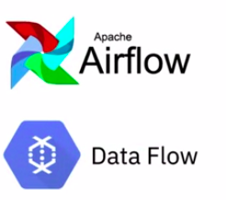
1. Data Pipeline

Slide 18
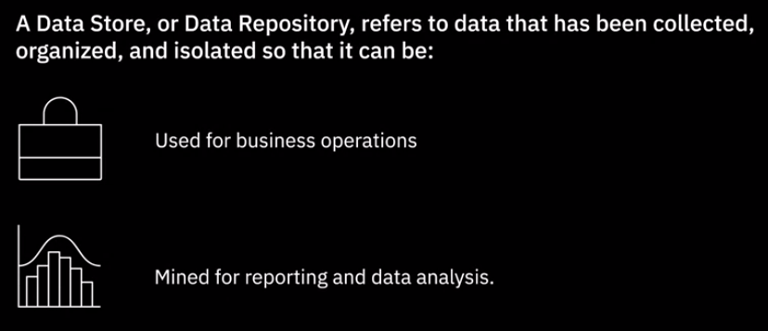
2. Factor for Selecting and Designing Data Stores

Slide 19
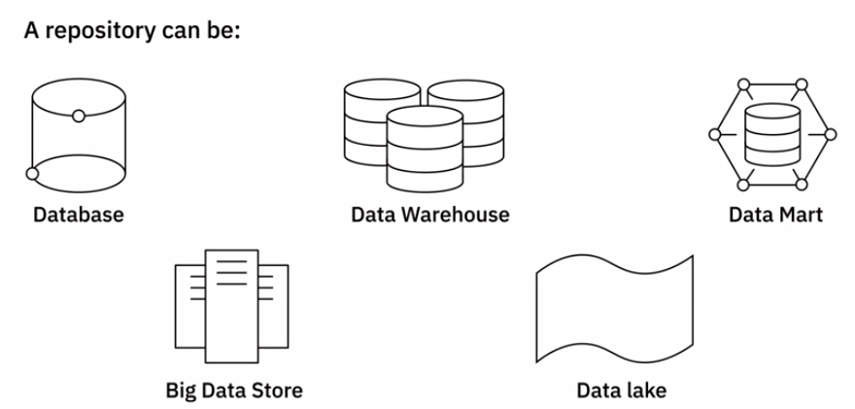
2. Factor for Selecting and Designing Data Stores
A well-designed data repository is essential for building a system that is scalable and capable of performing during high workloads

Slide 20
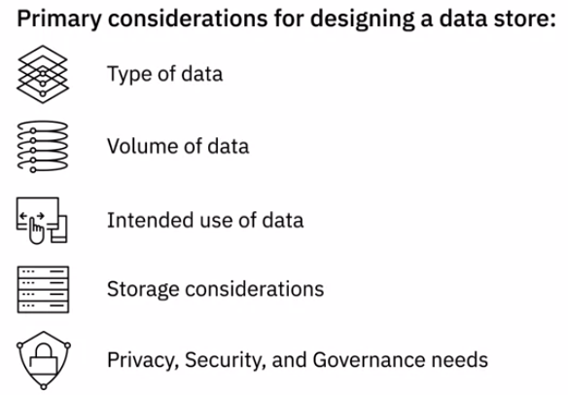
2. Consideration for Designing Data Stores

Slide 21
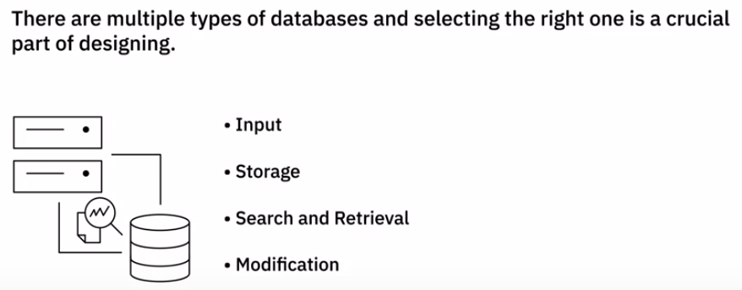
2. Types of databases
A database is essentially a collection of data designed for:
Depending on the type of data, databases can be categorized in two primary ways – relational and non-relational

Slide 22
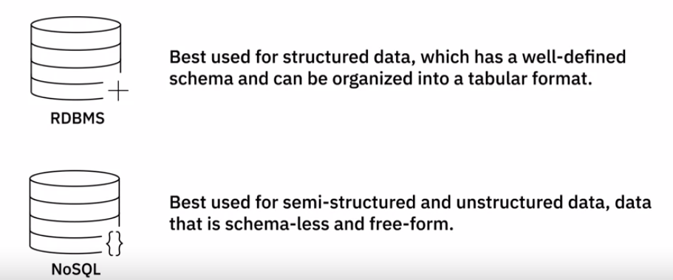
2. Types of databases
AWS RDS /Aurora
Non-relational databases, based on the type of data and how you want to query the data,

Slide 23
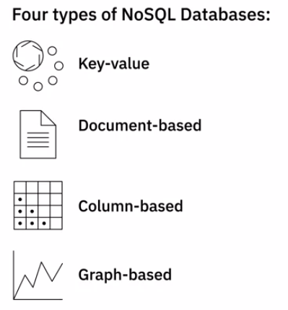
2. Types of databases
Examples:
If you're looking to run complex search queries and multi-operation transactions,
→ for example, a document-based database may not be the best option for you.
Graph-based database if you need to process high-volume transactions because graph-based databases are not optimized for large-volume analytics queries.
AWS Dynamo DB : Key-value
AWS Document DB : Document based
AWS QLDB : ledger/column based
AWS Neptune : Graph based

Slide 24
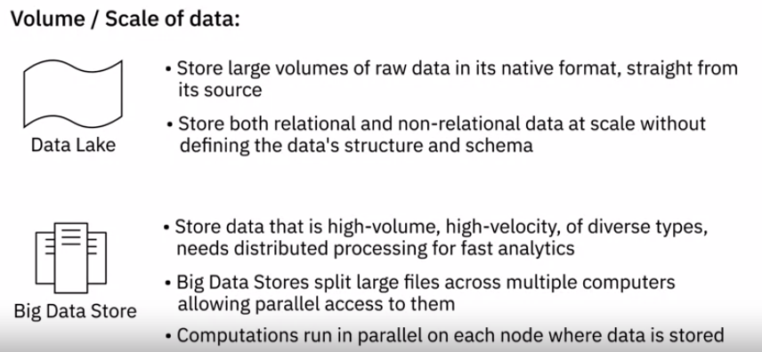
2. Volume of Data

Slide 25
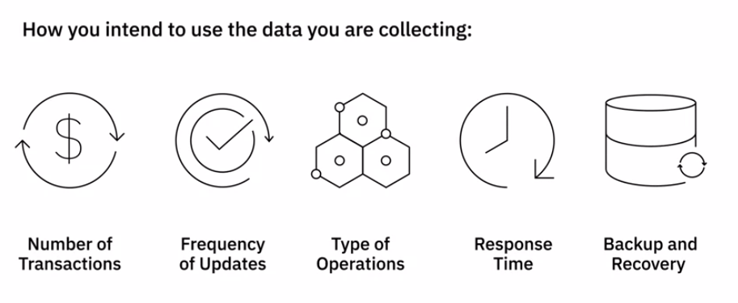
2. Intended use of Data
How you intend to use the data you are collecting is also an important consideration for the choice and design of a data store.

Slide 26
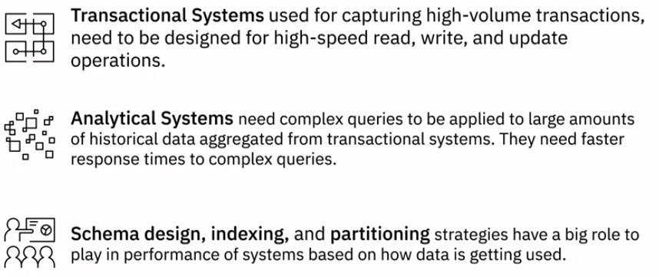
2. Intended use of Data

Slide 27
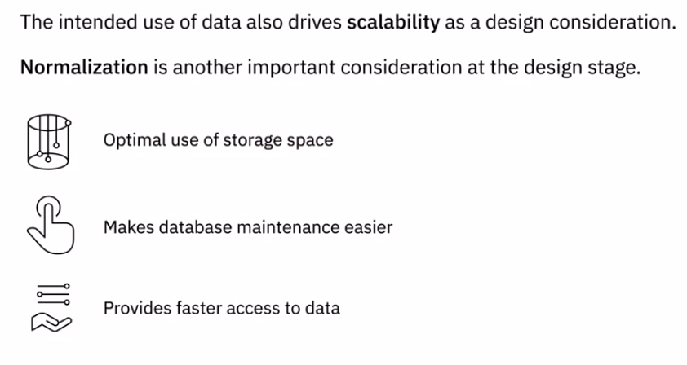
2. Intended use of Data
Normalization of the database is another important consideration at the design stage.
Normalization is the process of efficiently organizing data in a database.

Slide 28
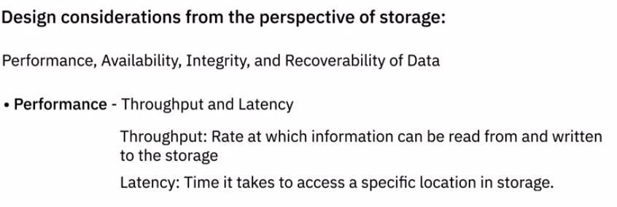
2. Storage Consideration - Performance

Slide 29
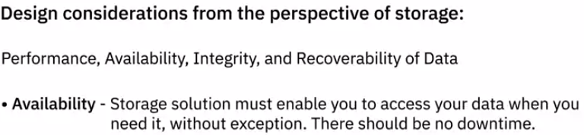
2. Storage Consideration - Availability / Integrity / Recoverability

Slide 30
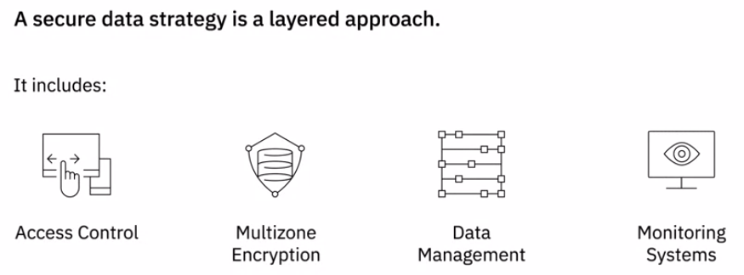
2. Privacy, Security, Governance

Slide 31
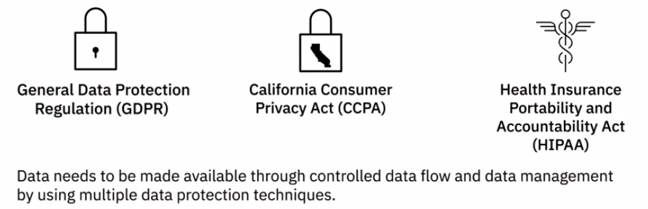
2. Privacy, Security, Governance
Regulations such as GDPR, CCPA, and HIPAA restrict the ownership, use, and management of personal and sensitive data

Slide 32
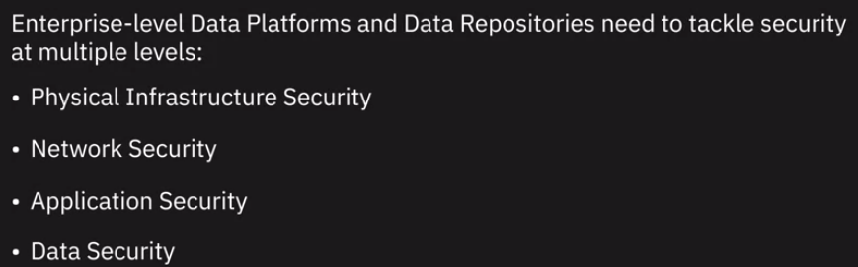
3. Security
PAN DA

Slide 33
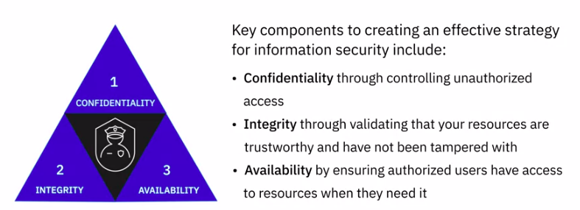
3. Security - The Confidentiality-Integrity-Availability (CIA) Trial

Slide 34
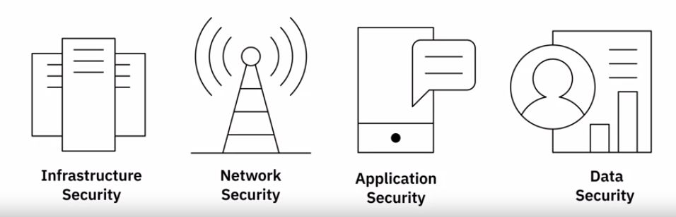
3. Security - All facets of security
Phy Infra- P
PAN DA

Slide 35
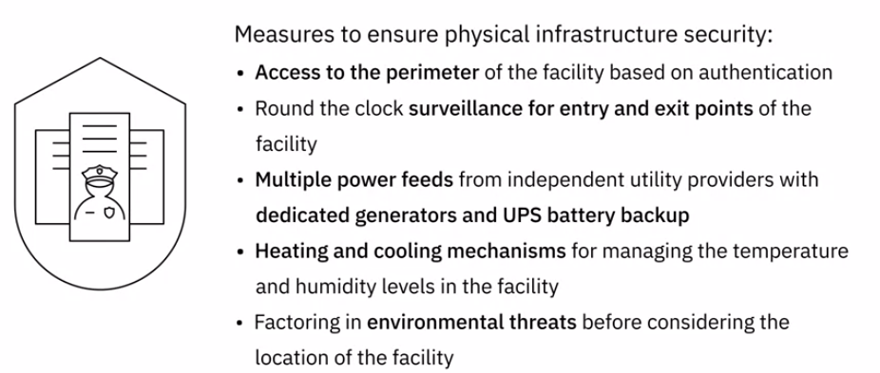
3. Security - Physical Infrastructure Security

Slide 36
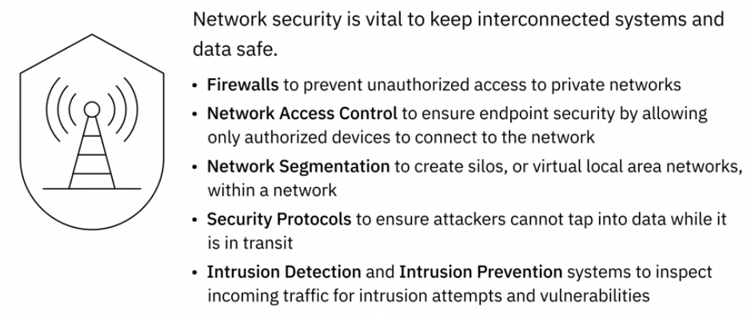
3. Security - Network Security

Slide 37
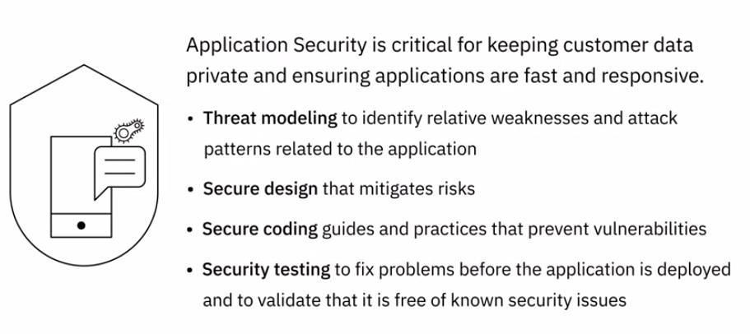
3. Security - Application Security

Slide 38
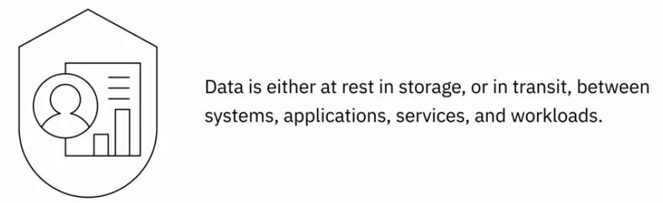
3. Security - Data Security

Slide 39
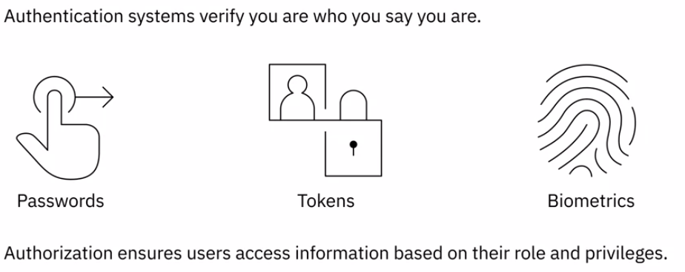
3. Security - Data Security

Slide 40
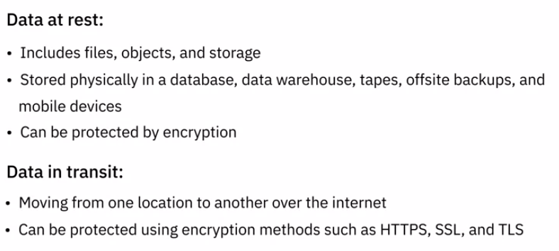
3. Security - Data Security
HTTPS : Hypertext Transfer Protocol Secure
SSL : Secure Socket Layer
TLS : Transport Layer Security
later on in the course you will learn more about the different stages of data life cycle the vulnerabilities data can be exposed to and the security features that help protect data end to end through its life cycle it is vital to proactively monitor track and react to security violations in time

Slide 41
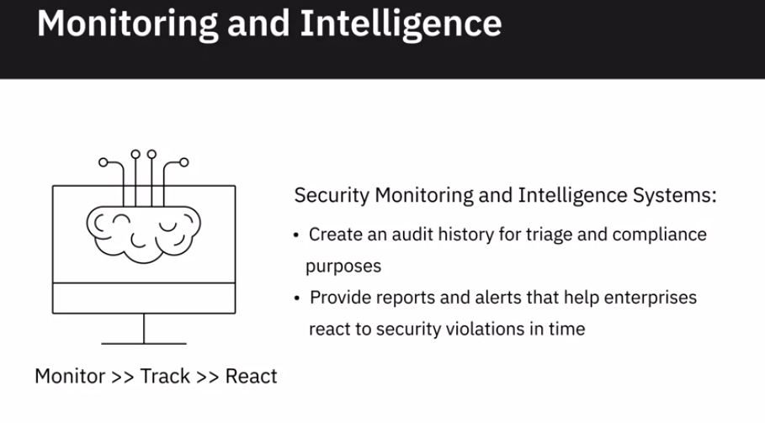
3. Security - Monitoring and Intelligence

Slide 42
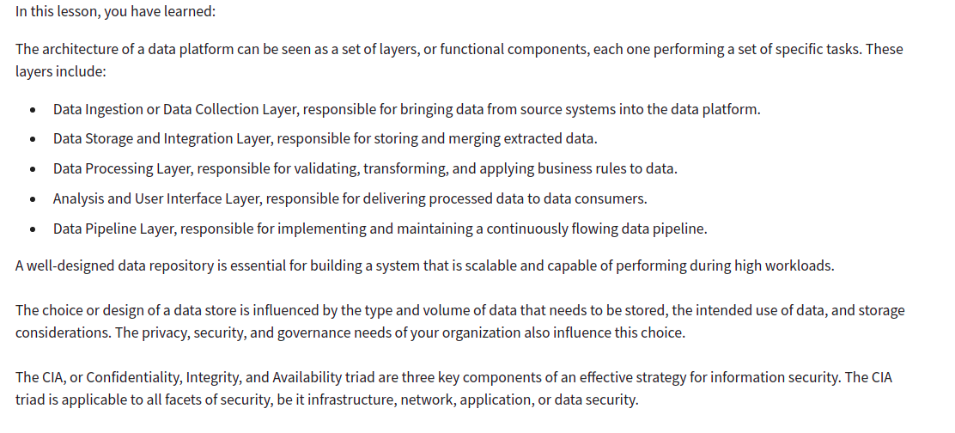
Recap

Slide 43
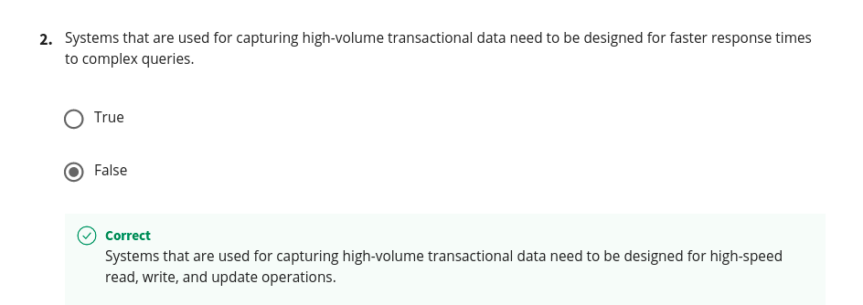
Recap

Slide 44
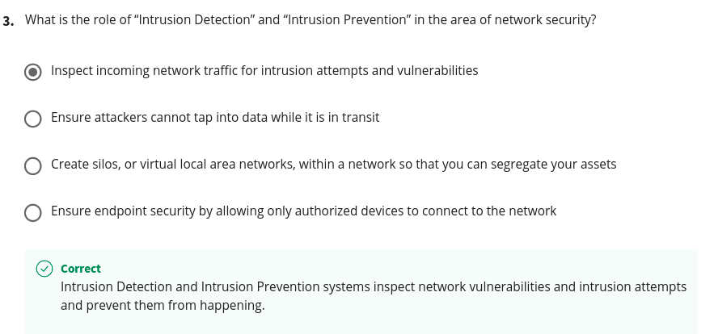
Recap

Slide 45
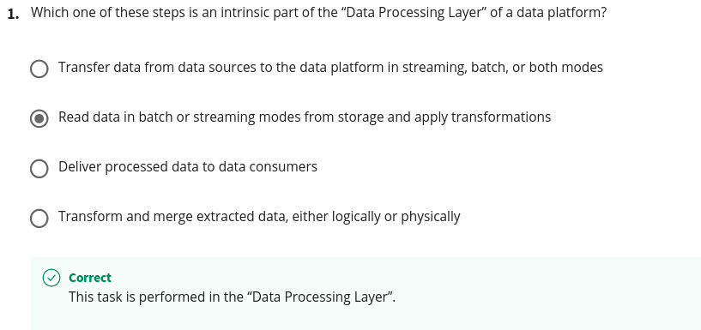
Quiz

Slide 46

Quiz

Slide 47

Quiz

Slide 48

Quiz

Slide 49

Quiz

